Slide 1
Foreign Excursion Tour 2022
“Make Buisco great agian!”

Slide 2
Table of contents
Purpose
Selection Procedure
Registration
Travel Plan
Corona Plan B
Important Data
Summary

Slide 3
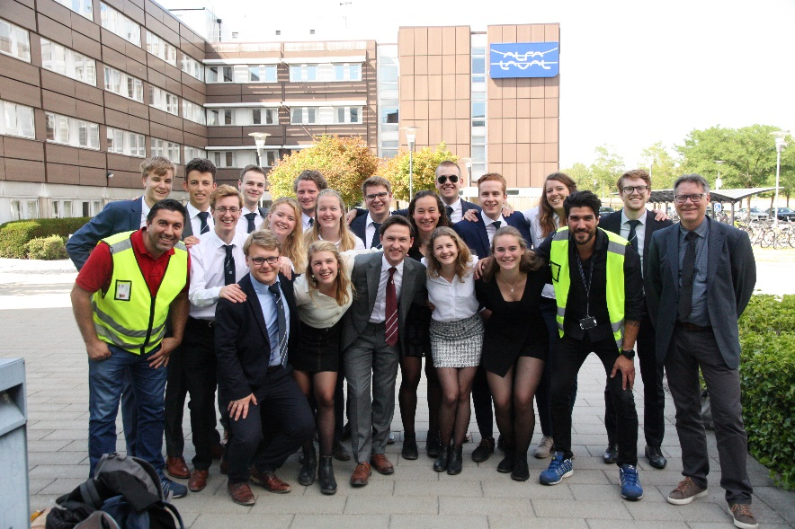
Purpose
Study trip
Students in contact with chemical industry
Companies, culture, learning and fun combined!

Slide 4
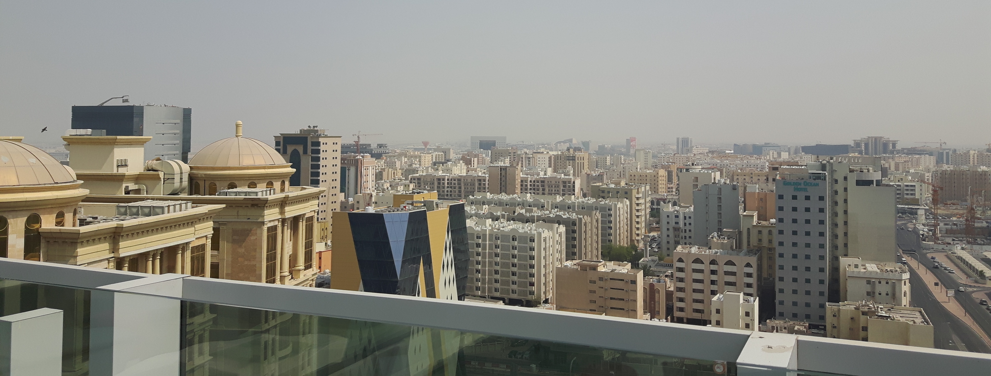
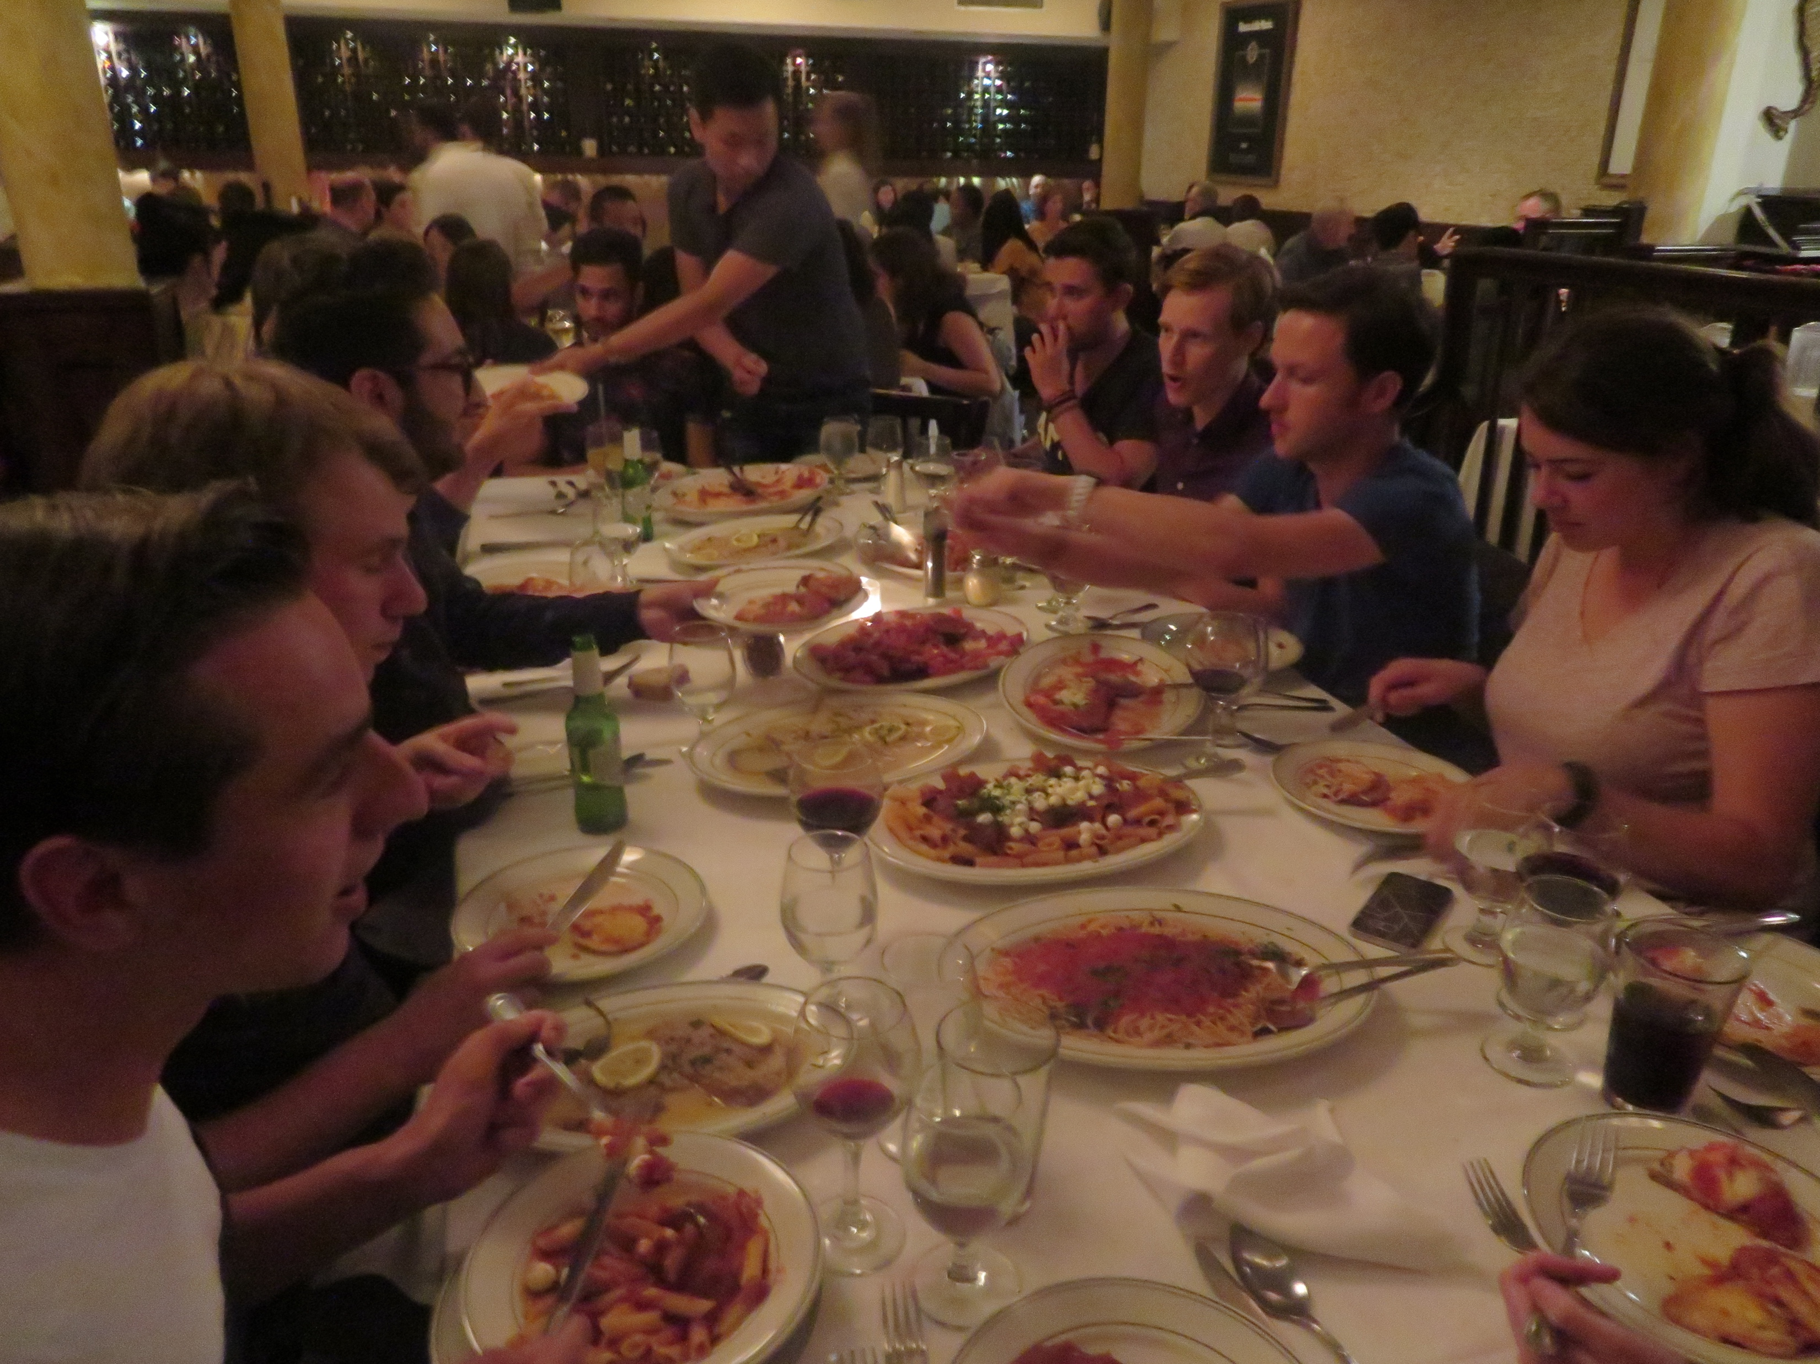
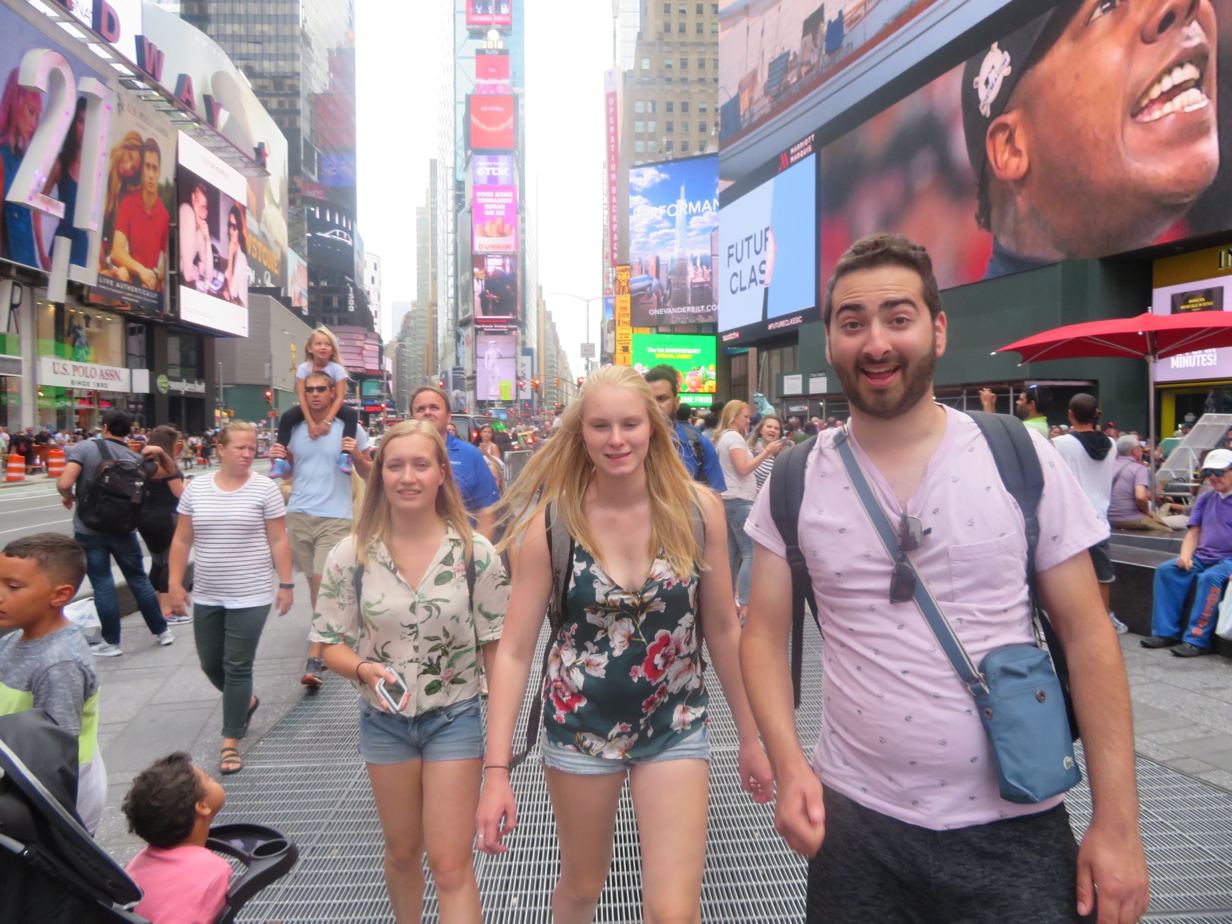
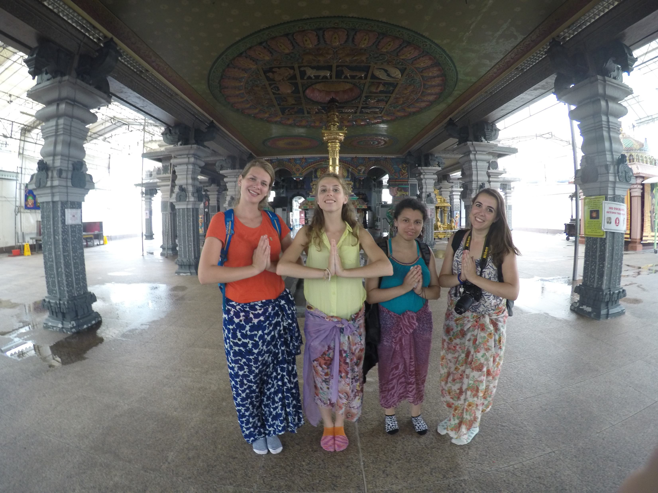
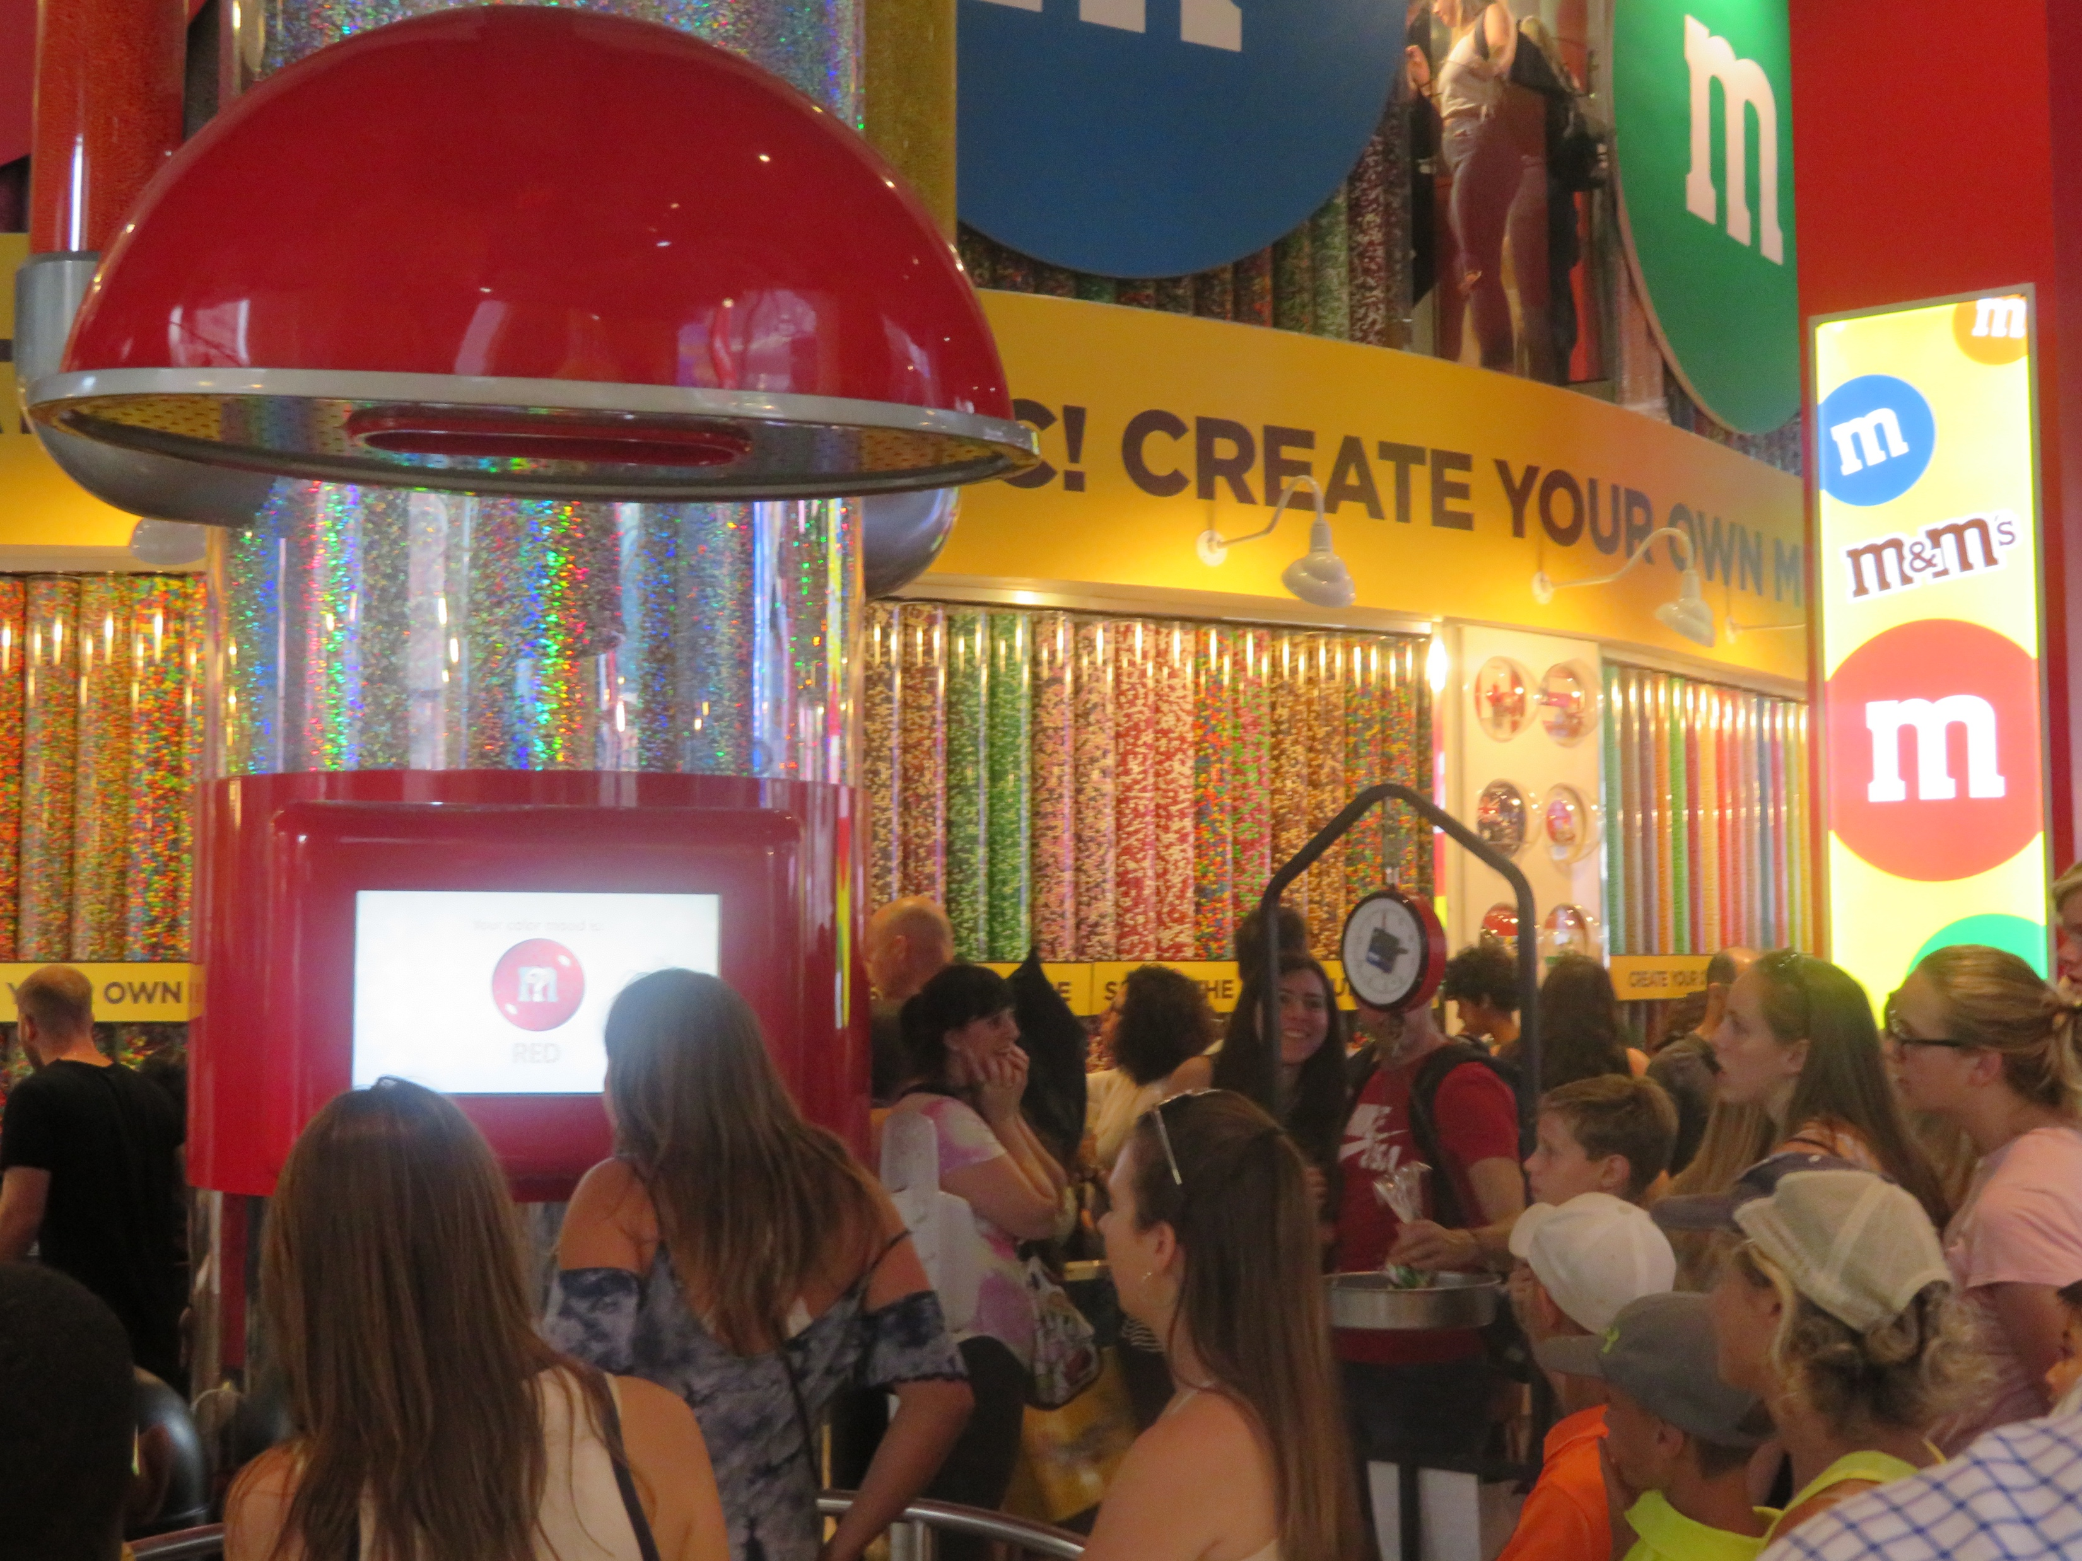
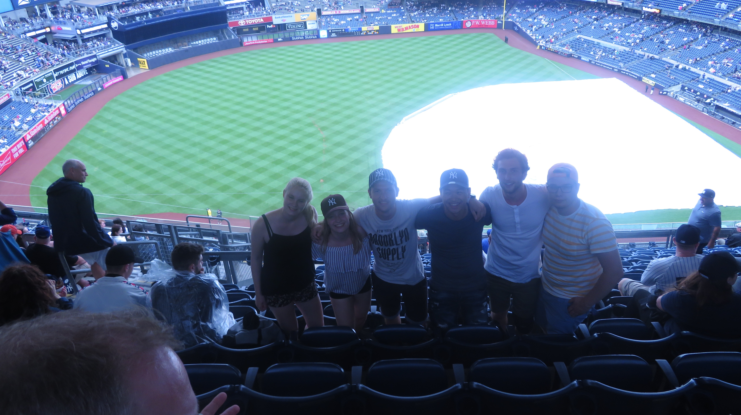
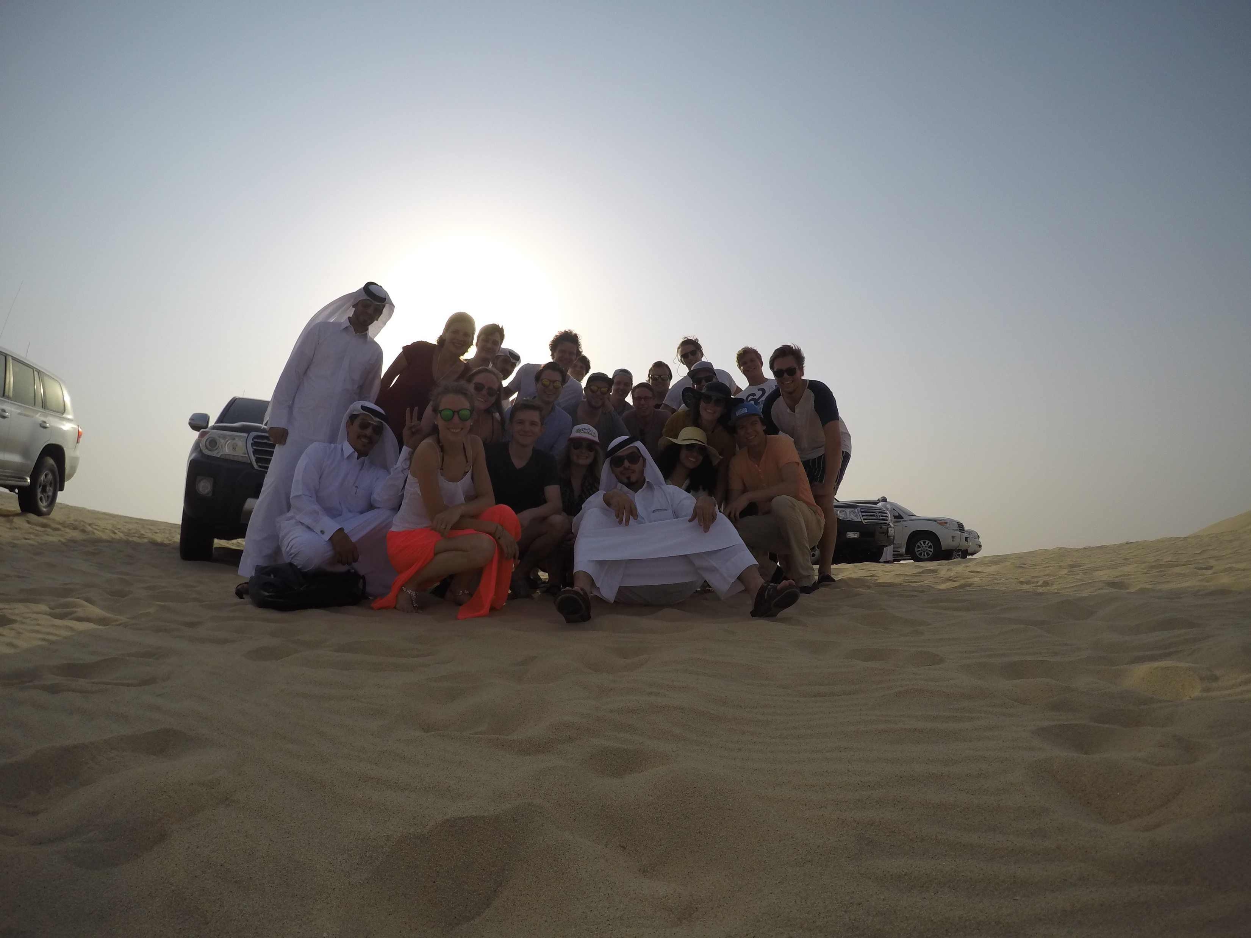
Atmosphere impression previous FETS

Slide 5
Selection Procedure
25 Participants with 6 spots reserved for the committee
Ratio bachelor/master students based on the ratio of valid applications
A valid application is a member of TG in at least their third year of the bachelor MST or from the master CE

Slide 6
Selection Procedure
Candidate-participants will be sorted into six different groups by the following criteria:
A candidate-participant has a minimum of 102 ECTs (MST) on November 26th 2021.
A candidate-participant has completed all first year courses (of the bachelor) on November 26th 2021.
A candidate-participant has not already participated in a previous Foreign Excursion Tour.
A candidate-participant has shown an appropriate motivation in the motivation letter. (Motivation letters will be looked at anonymously by the Buisco)

Slide 7
Selection Procedure
The six groups of participant-candidates:
A candidate-participant meets all 4 criteria
A candidate-participant meets criteria 1,2 and 4, and is an old member of the foreign excursion tour committee
A candidate-participant meets criteria 1, 2 and 4, but has already participated in a previous Foreign Excursion Tour.
A candidate-participant doesn’t meet criteria 4, but meets criteria 1-3
A candidate-participant meets criteria 1, 3 and 4, but doesn’t meet criteria 2.
A candidate-participant meets criteria 2, 3 and 4, but doesn’t meet criteria 1.
Criteria:
A candidate-participant has a minimum of 102 ECTs on November 26th 2021.
A candidate-participant has completed all first year courses on November 26th 2021.
A candidate-participant has not already participated in a previous Foreign Excursion Tour.
A candidate-participant has shown an appropriate motivation in the motivation letter. (Motivation letters will be looked at anonymous by the Buisco)

Slide 8
Selection Procedure
Send a signed version of the ‘Candidate-participants selection contract’ including motivation letter to Fet-TG@tudelft.nl. (This document will be sent to all people who subscribed for this lunch on the website!)
Deadline for applications is on 26th of November 22:22
Participants will be drawn on 2nd of December 13:00

Slide 9
Registration
After the participants are announced, registrations open
Hand in a copy of the signed ‘Participant contract’ to Fet-TG@tudelft.nl before the 22th of December 17.00
You need to be fully vaccinated before the tour according to US guidelines!
Total costs: €1000,-
Payment options: in 3 installments (january, march, may) or at once
Ultimate payment deadline = 25th of May

Slide 10
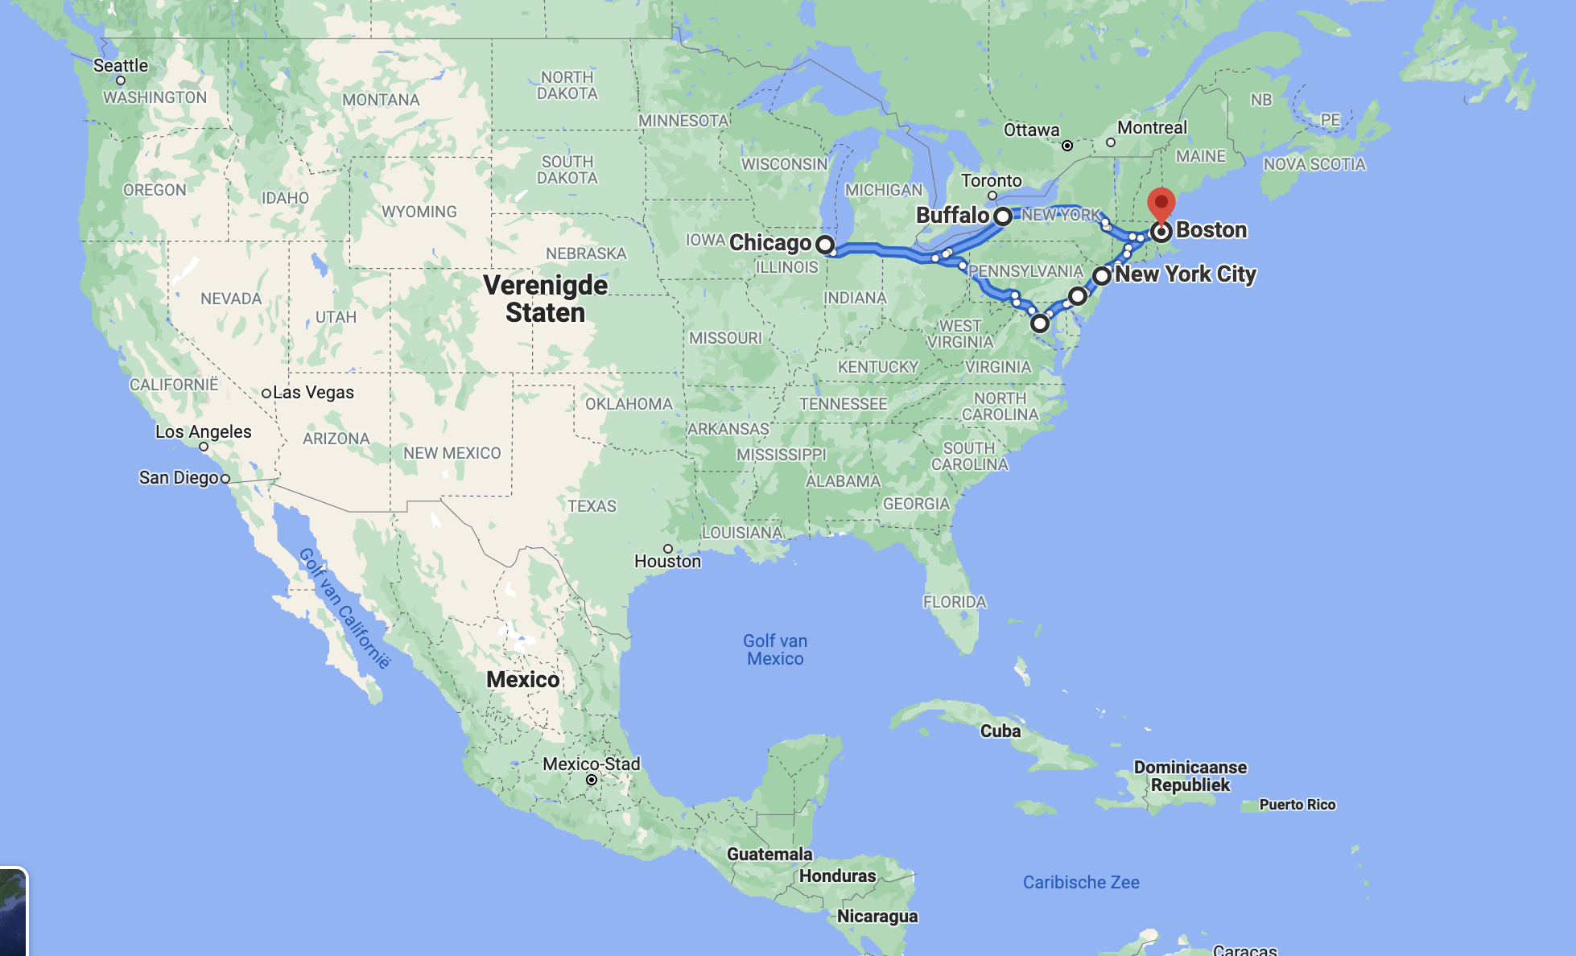
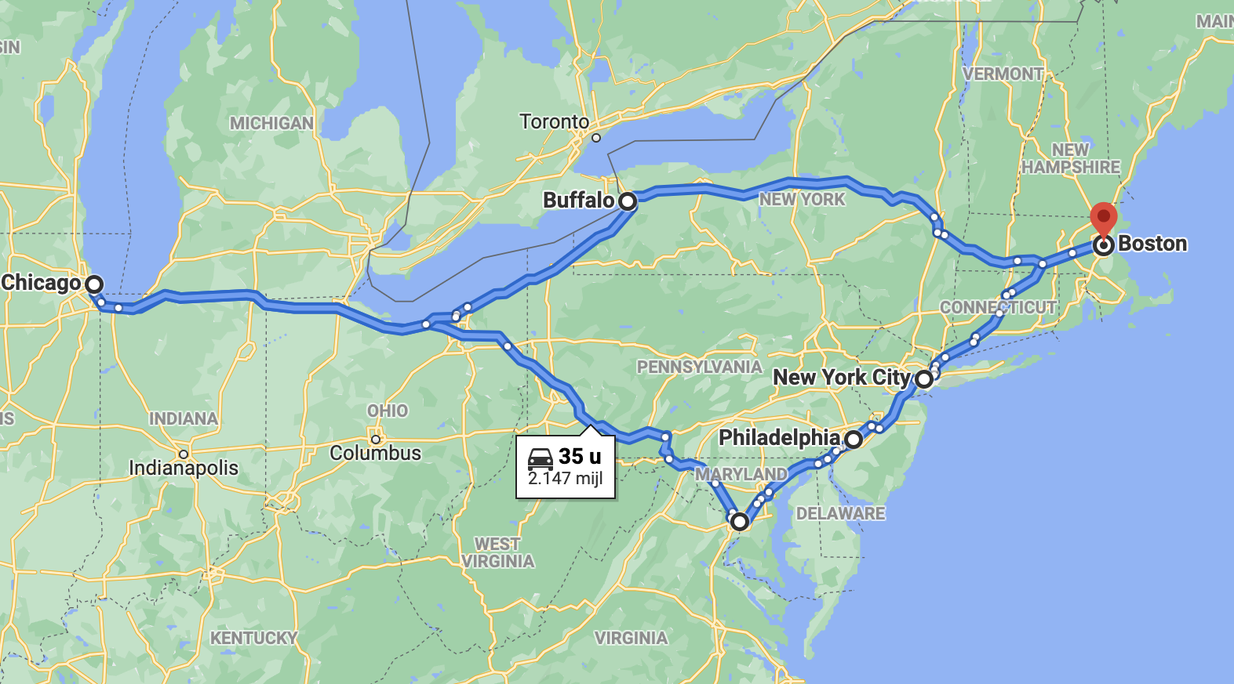
Travel Plan
Amsterdam -> Boston
New York
Philadelphia
Washington
Chicago ->
Buffalo
Easy access to Niagara falls!
Boston -> Amsterdam

Slide 11
Corona plan B
Unfortunately, we can’t look into the future either!
Corona go/no-go moment on March 1st
Alternative trip in Europe
Not interested in this alternative trip? = refund to best expense
For free spaces –> subscriptions open up again

Slide 12
Important Data
15-10-2021 Applications opened
26-11-2021 22:22 Applications closed
02-12-2021 13:00 Drawing of participants
22-12-2021 17:00 Deadline copy of registration
01-03-2022 Covid-19 go/no-go moment
25-05-2022 Payment deadline
06-05-2022 17:00 Pre-FET activity (non-mandatory)
17-05-2022 17:00 Pre-FET activity (mandatory)
04-07-2022 First day of case study
15-07-2022 Last day of case study
18-07-2022 First day of the FET
09-08-2022 Last day of the FET

Slide 13
Summary
Study trip through the Unites States
Selection procedure
Application deadline 26-11-2021 22:22
Corona measures remain a mystery (even for us)
Costs €1000,-
Feel free to contact us at Fet-TG@tudelft.nl or ask a member of the Buisco (Foreign Excursion Tour committee) personally

Slide 14
